Slide 1

IAMC ANNUAL MEETING 14-16 NOVEMBER 2022, VENICE
Analyzing the trade-offs of sustainable diets on the long-term SDG goals
Clàudia Rodés-Bachs (BC3), Jon Sampedro,
Dirk-Jan Van de Ven, Russell Horowitz,
Xin Zhao and Guillermo Pardo
www.iam-compact.eu

Slide 2
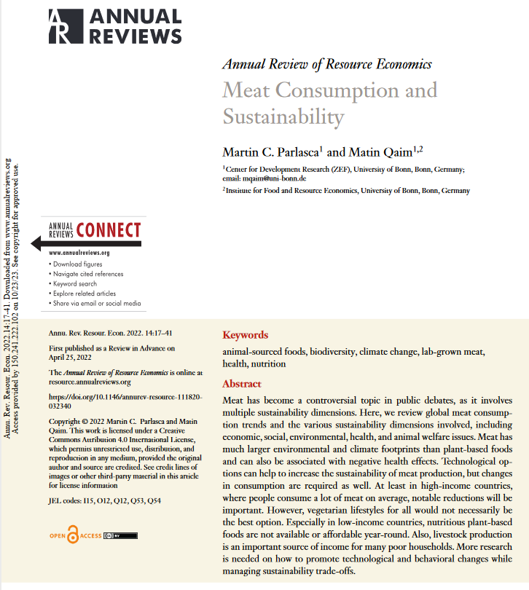
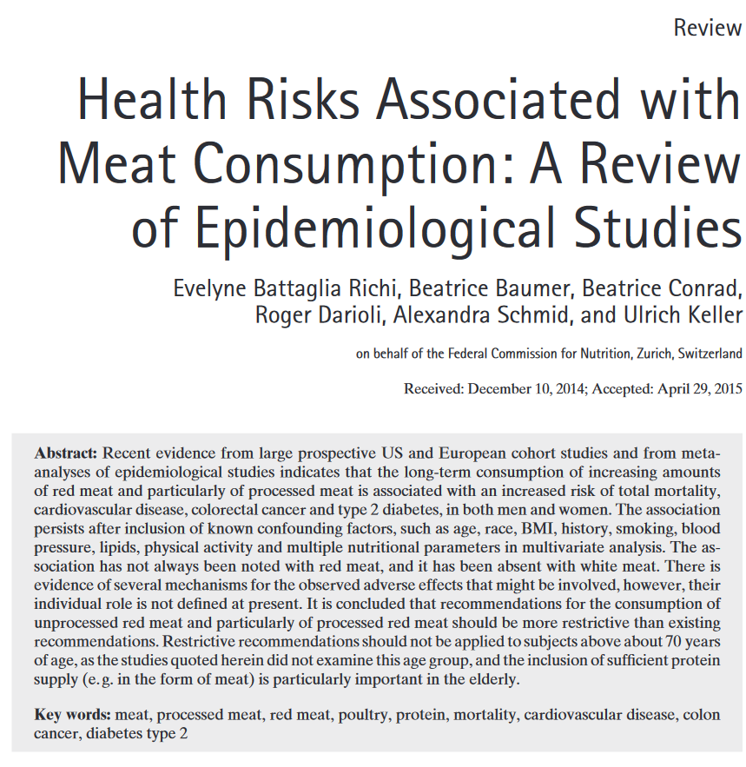
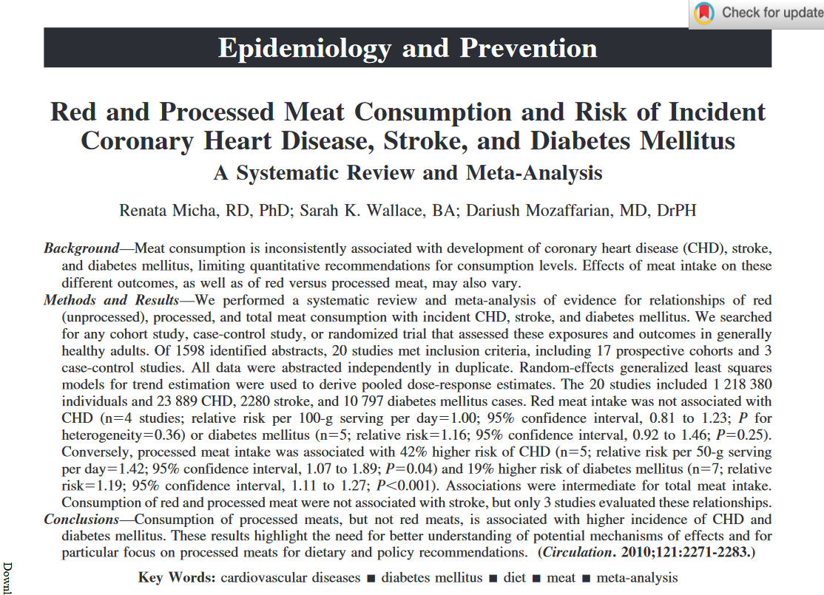
Motivation

Slide 3
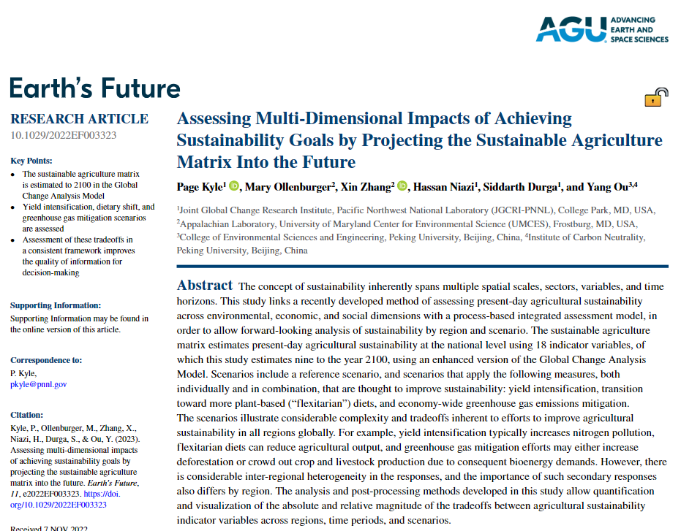
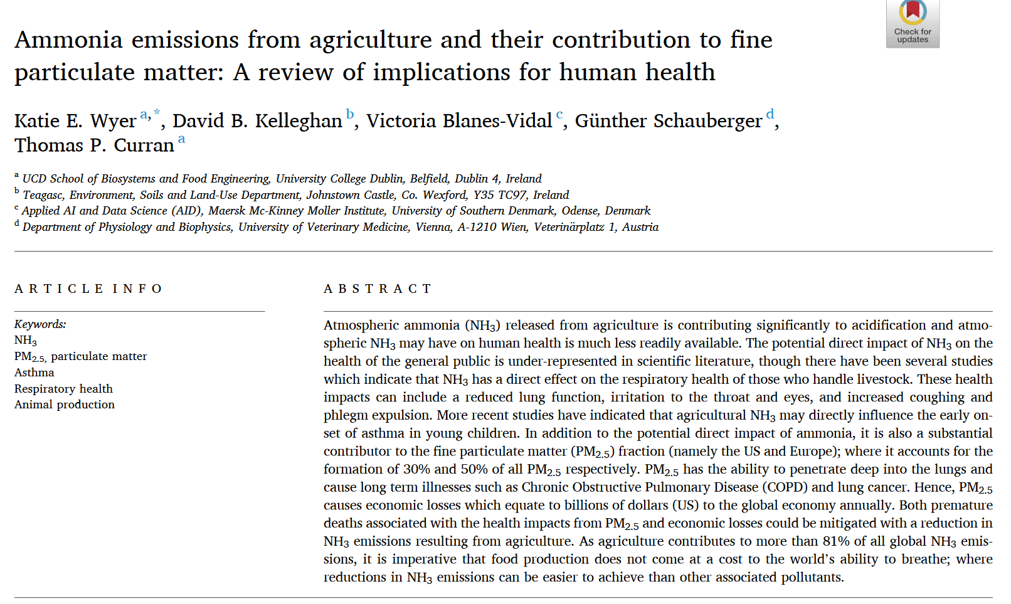
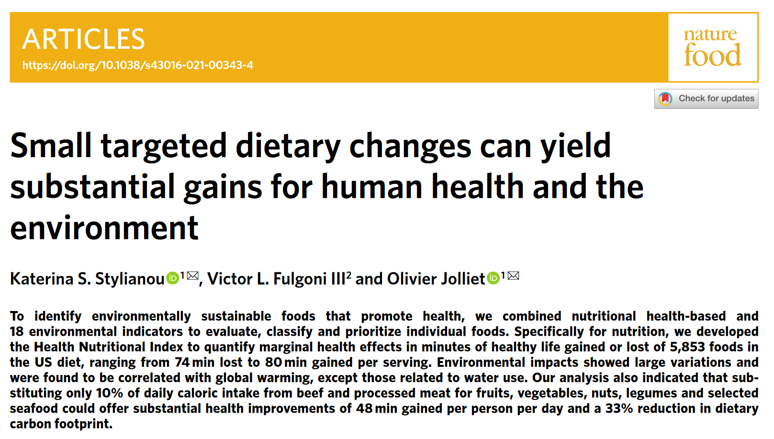
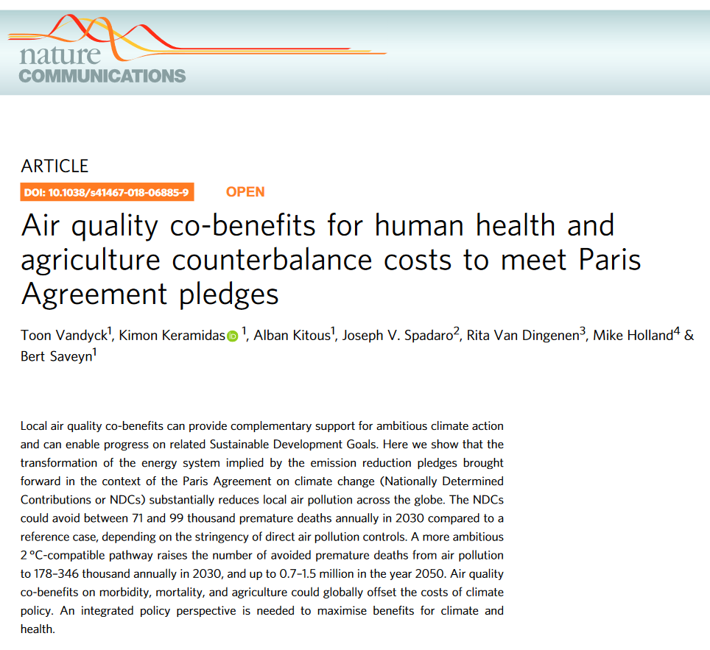
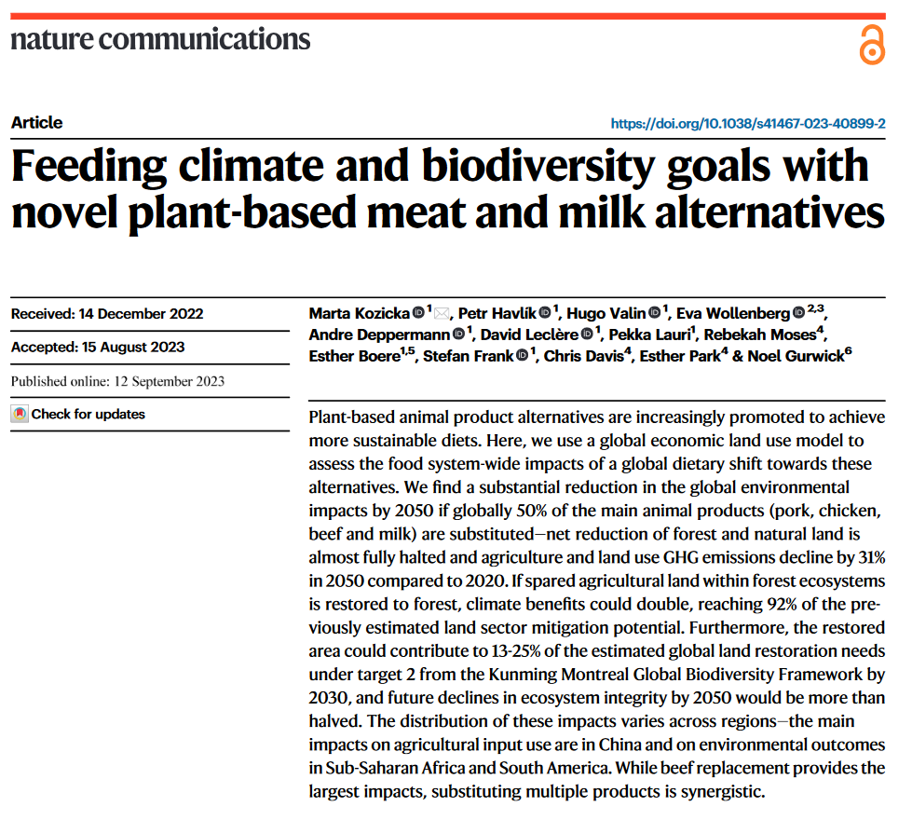
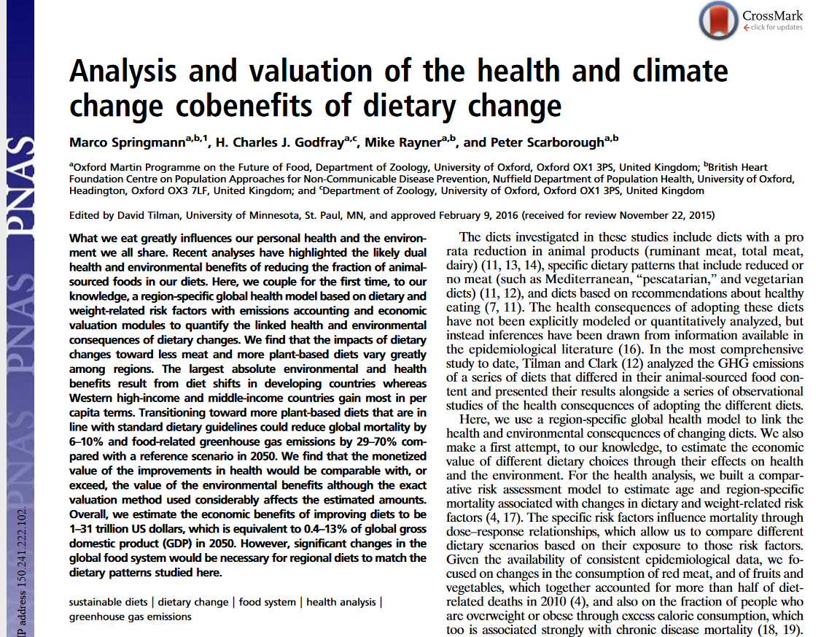
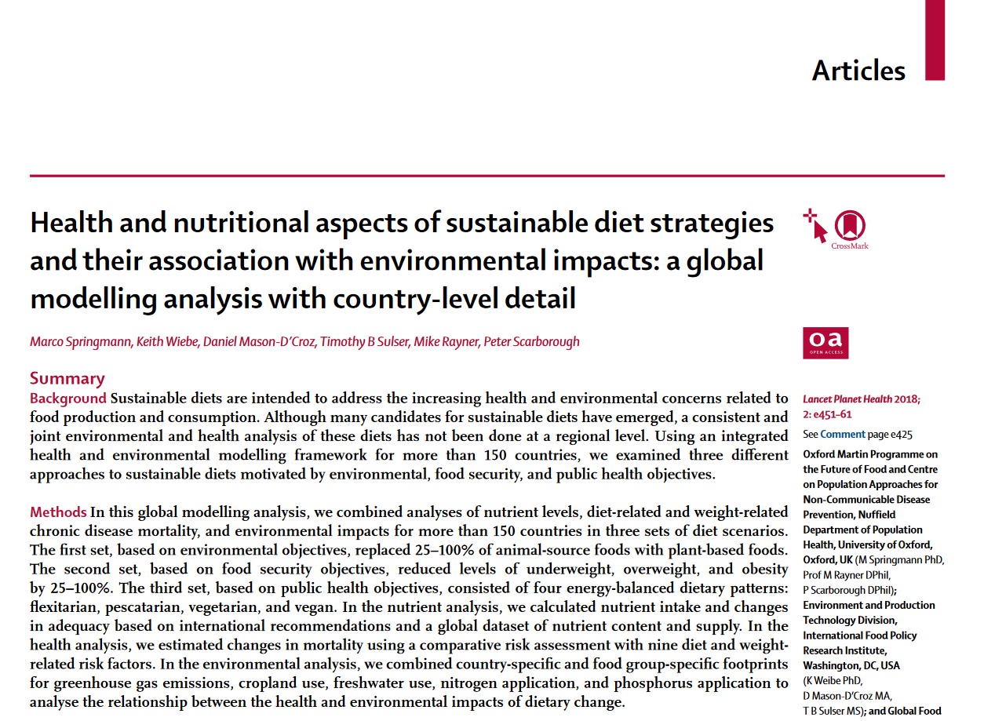
Motivation

Slide 4
Our goals
Q1. | Which will be the system-wide benefits of plant protein based diets?
Q2. | Which will be the system-wide benefits of no rumiants protein based diets?

Slide 5
Our goals
Q1. | Which will be the system-wide benefits of plant protein based diets?
Q2. | Which will be the system-wide benefits of no rumiants protein based diets?

Slide 6
Our goals
Q1. | Which will be the system-wide benefits of plant protein based diets?
Q2. | Which will be the system-wide benefits of no rumiants protein based diets?
SDG1. | Poverty
 | - Daily food expenditure per capita

Slide 7
Our goals
Q1. | Which will be the system-wide benefits of plant protein based diets?
Q2. | Which will be the system-wide benefits of no rumiants protein based diets?
SDG1. | Poverty
SDG2. | Alimentation
 | - Macronutrients consumption
 | - Micronutreitns consumption

Slide 8
Our goals
Q1. | Which will be the system-wide benefits of plant protein based diets?
Q2. | Which will be the system-wide benefits of no rumiants protein based diets?
SDG1. | Poverty
SDG2. | Alimentation
SDG3. | Health
 | - Premature deaths due to air pollution
 | - Nutritional health related issues

Slide 9
Our goals
Q1. | Which will be the system-wide benefits of plant protein based diets?
Q2. | Which will be the system-wide benefits of no rumiants protein based diets?
SDG1. | Poverty
SDG2. | Alimentation
SDG3. | Health
SDG6. | Water management
 | - Water consumption by crop and livestock
 | - Irrigated and Rainfed water demand

Slide 10
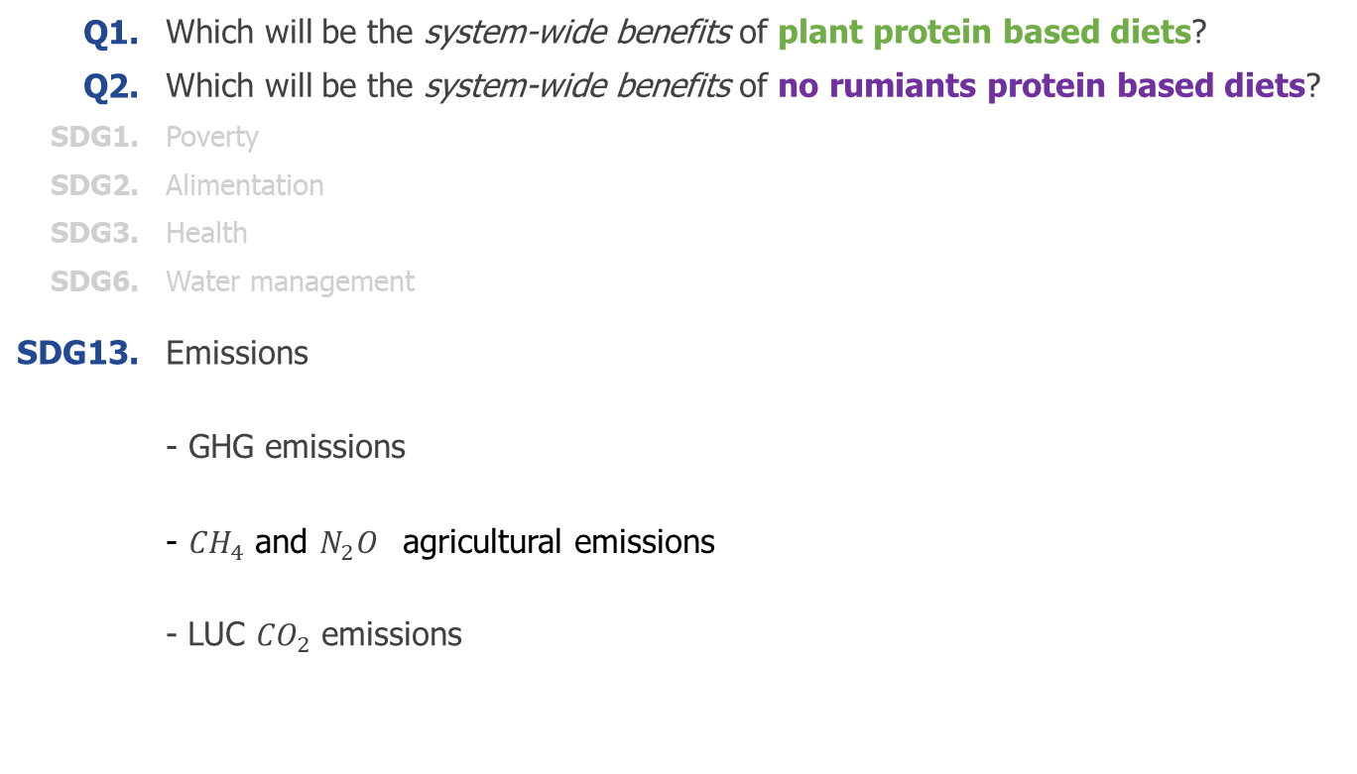
Our goals
Q1. | Which will be the system-wide benefits of plant protein based diets?
Q2. | Which will be the system-wide benefits of no rumiants protein based diets?
SDG1. | Poverty
SDG2. | Alimentation
SDG3. | Health
SDG6. | Water management
SDG13. | Emissions
 | - GHG emissions
 | - ${CH}_{4}$ and $N_{2}O^{}$agricultural emissions
 | - LUC ${CO}_{2}$ emissions

Slide 11
Our goals
Q1. | Which will be the system-wide benefits of plant protein based diets?
Q2. | Which will be the system-wide benefits of no rumiants protein based diets?
SDG1. | Poverty
SDG2. | Alimentation
SDG3. | Health
SDG6. | Water management
SDG13. | Emissions
SDG15. | Land Use
 | - Distribution of land use aread
 | - Re-forestation
 | - Fertilizer demand
 | - Crop loss due to air pollution
 | - Carbon stock

Slide 12



















Scenarios
Rumiants’ protein
Animal protein
Fish
protein
Monogastrics’ protein
Plant
protein
Plant protein
plant protein based diets
no rumiants protein based diets
Icons from https://www.flaticon.com/
Notes:
<a href="https://www.flaticon.com/free-icons/cow" title="cow icons">Cow icons created by Flat Icons - Flaticon</a>

Slide 13
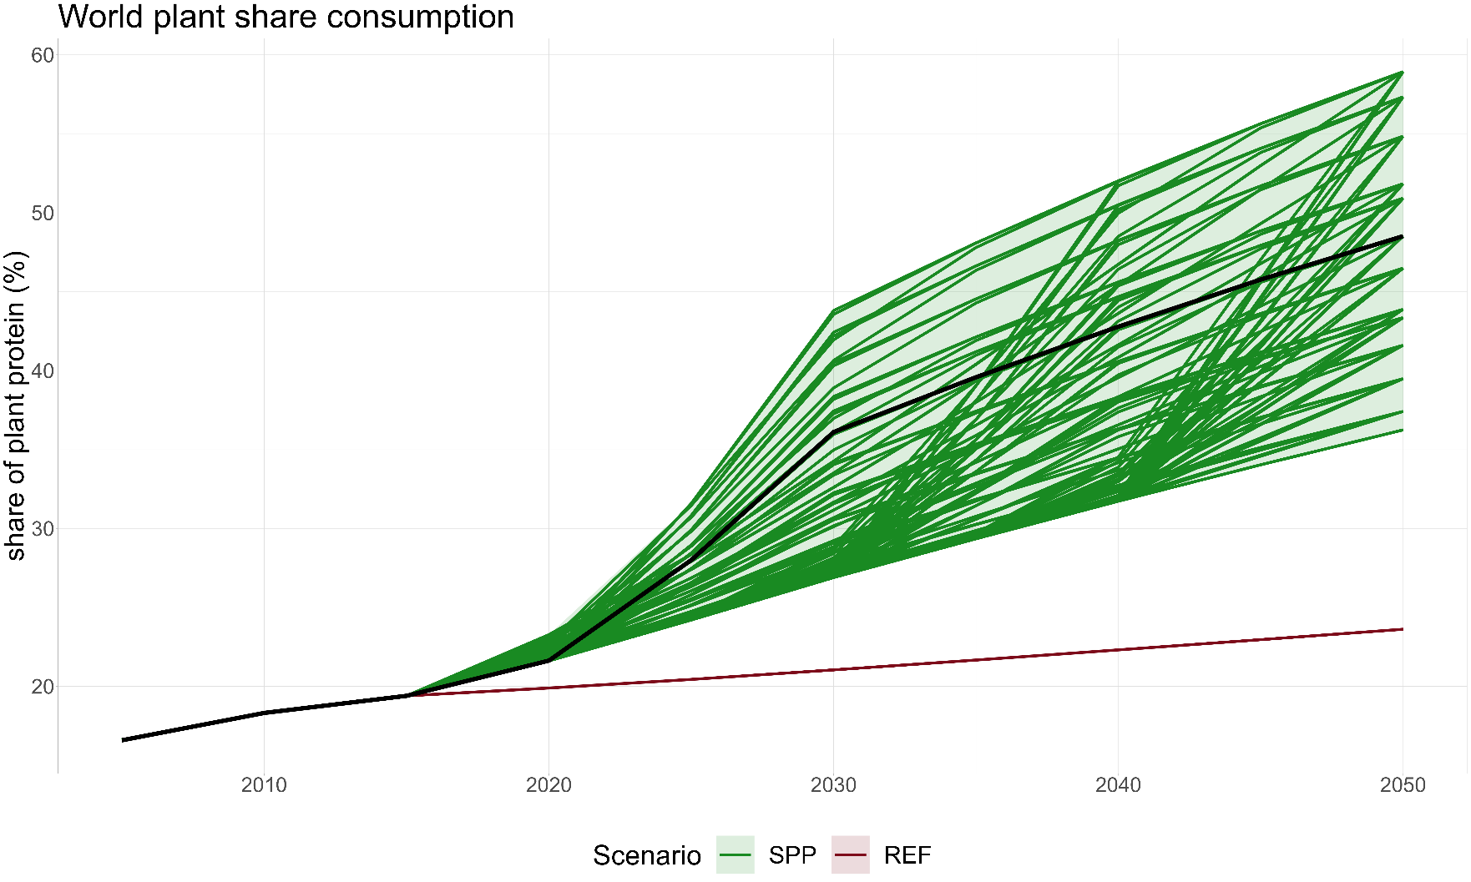


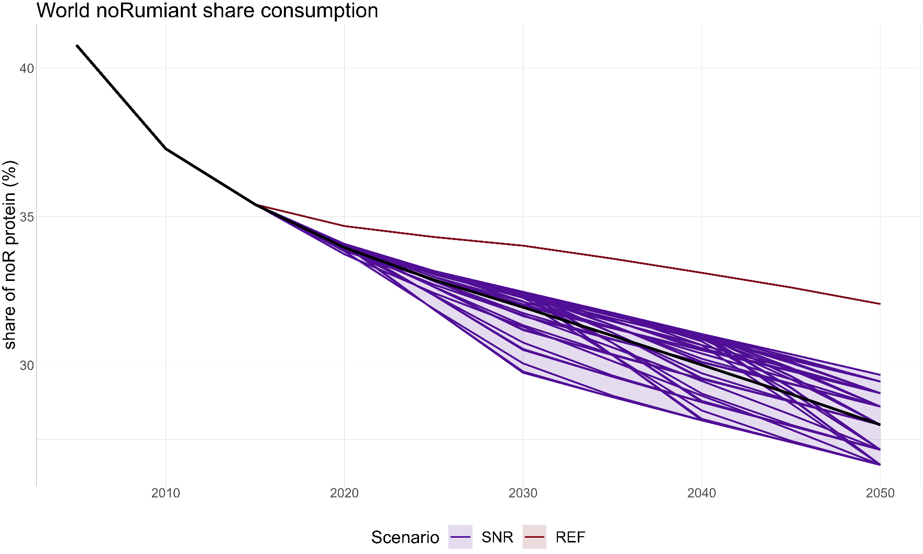
Scenarios
peak year
final share
Based on logistic curves
slope
Fig baseline + all runs
world

Slide 14
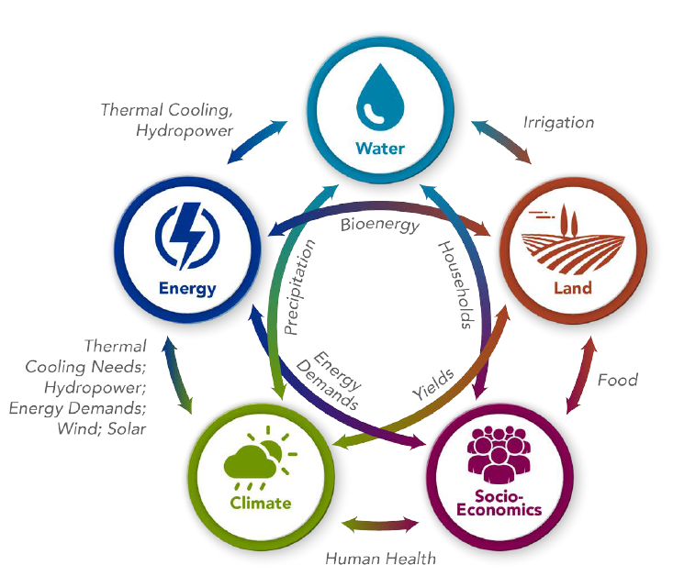
The model: GCAM

Slide 15
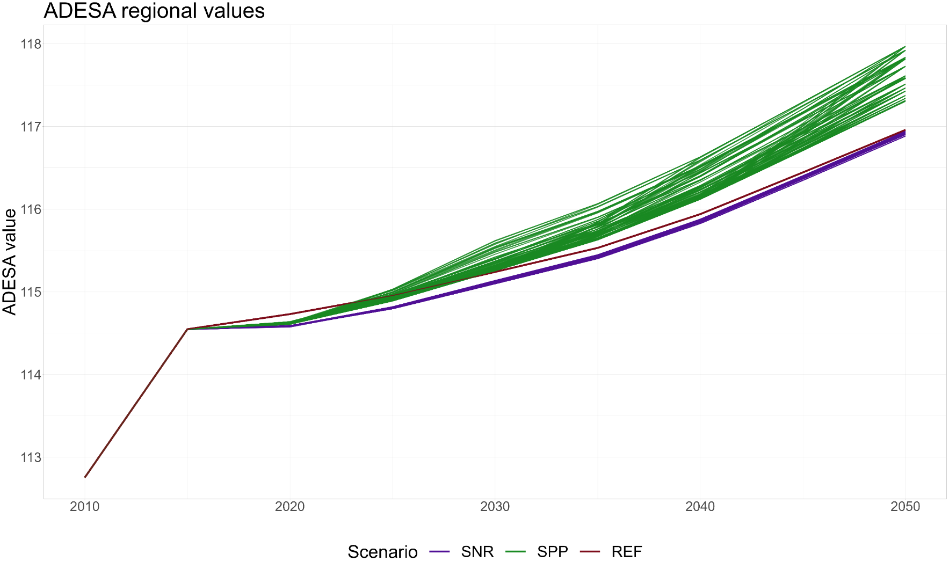
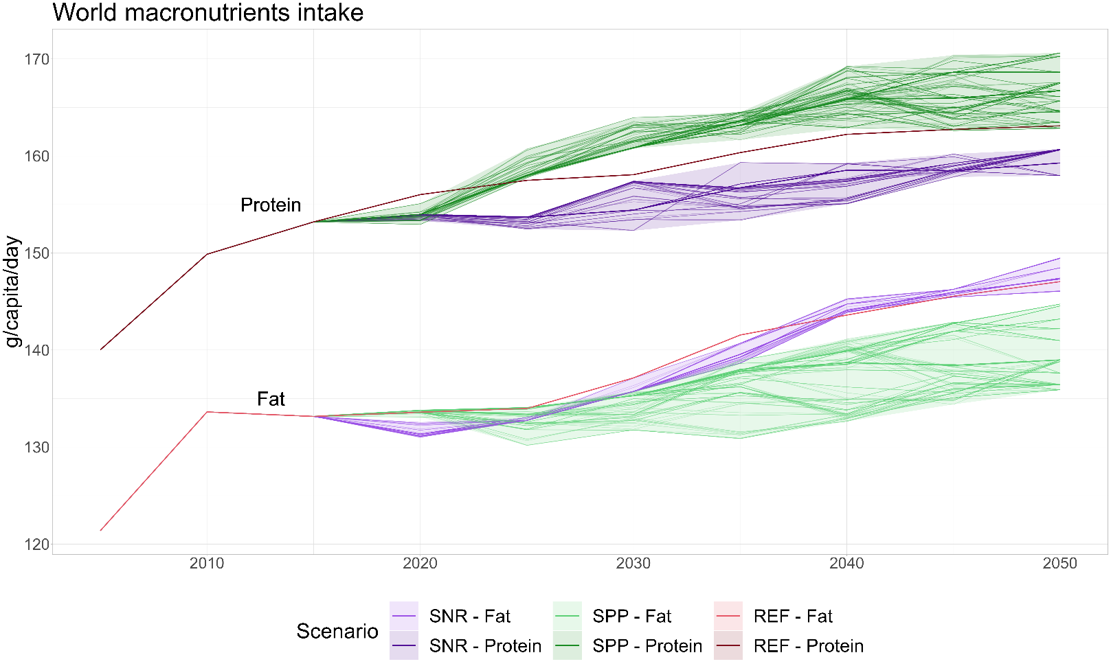
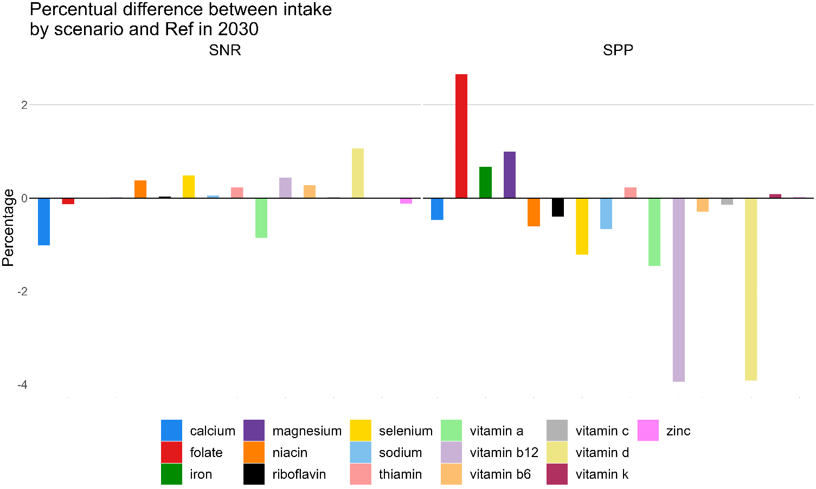
Nutritional point of view
Fig: Kcal intake

Slide 16
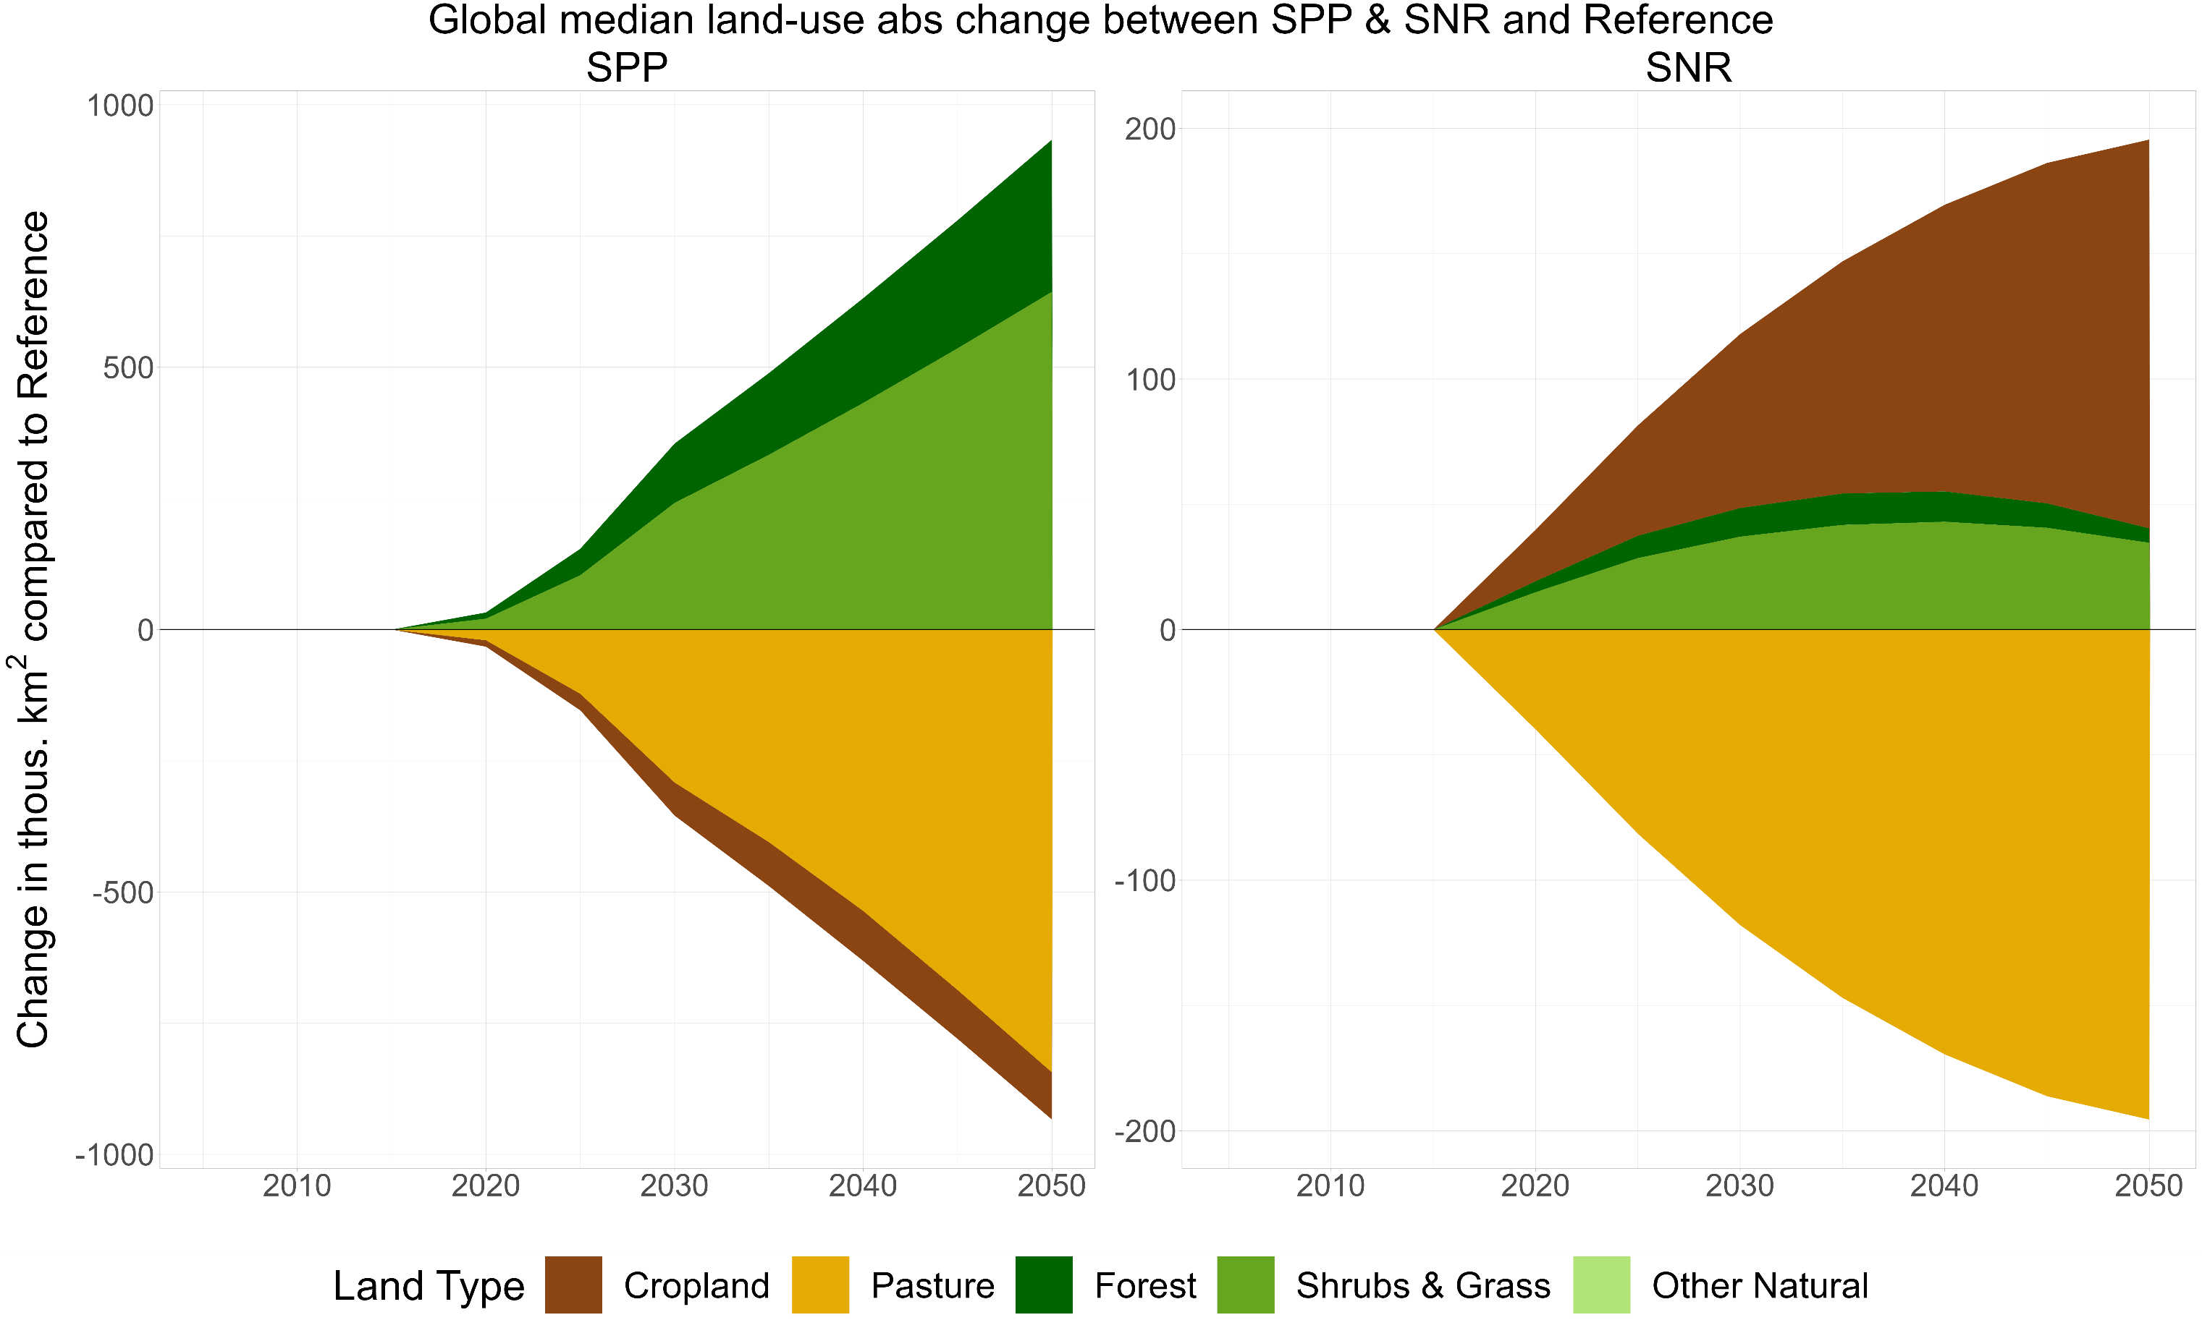
Land types
Fig: land use world

Slide 17
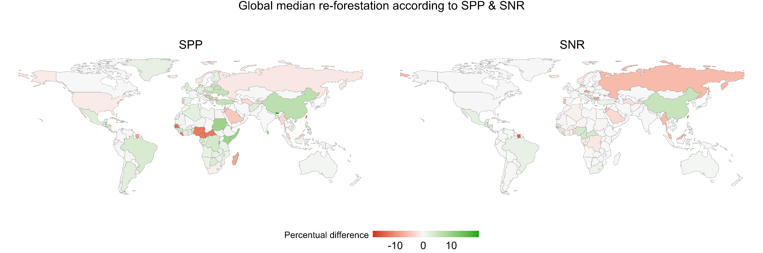
Re-forestation
Fig: re-forestation

Slide 18
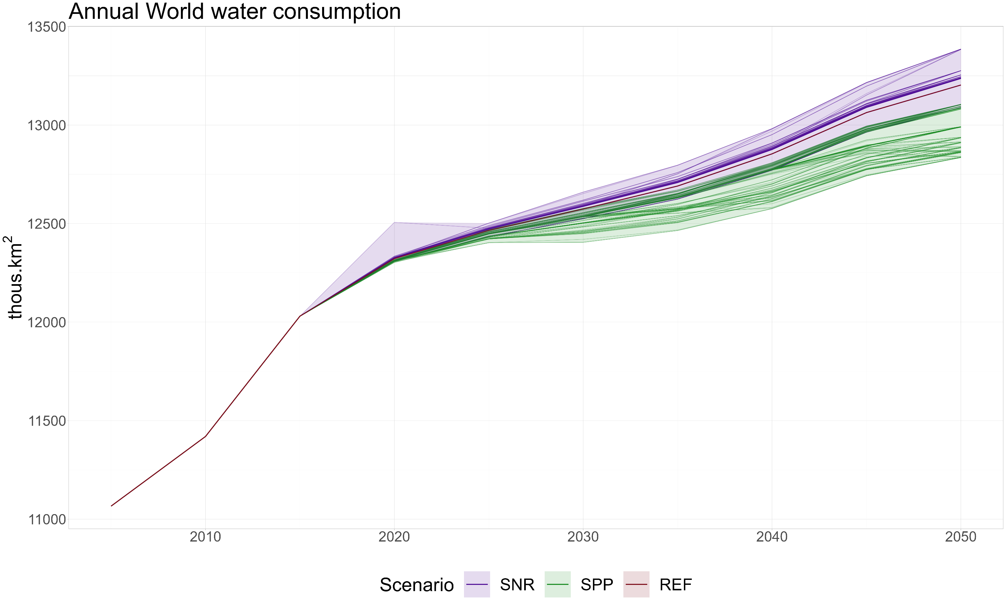
Water
Fig: water consumption

Slide 19
Water
Fig: water consumption

Slide 20
Water
Fig: water consumption

Slide 21
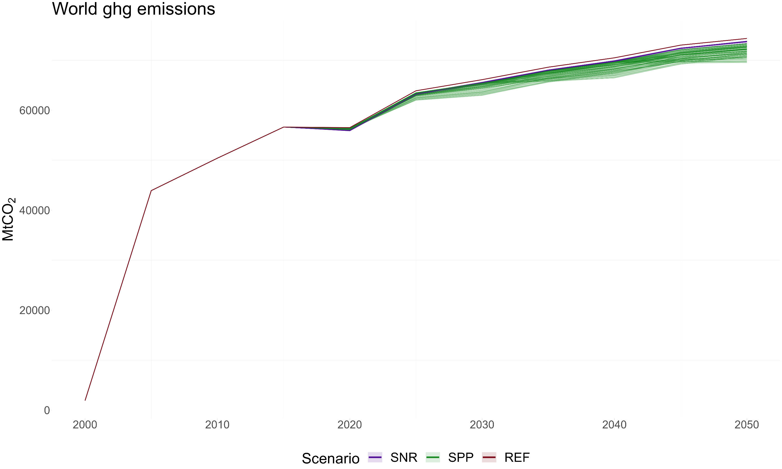
GHG emissions
Fig: ghg emissions

Slide 22
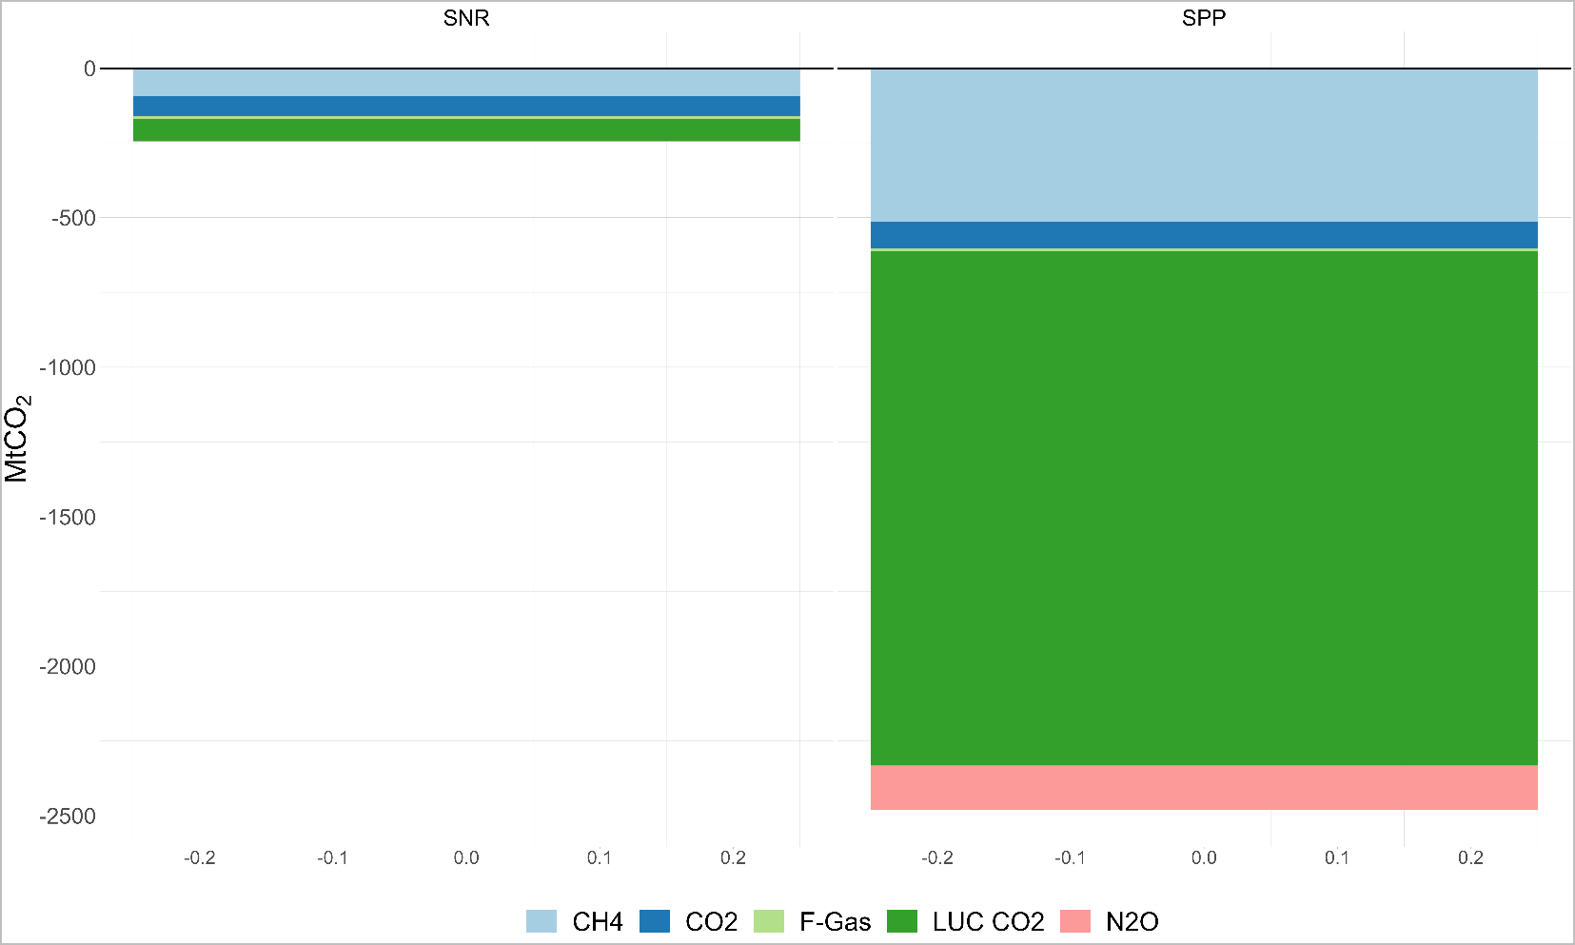
GHG emissions
Fig: ghg emissions

Slide 23
Nutritional point of view
Fig: avoided premature deaths due to AP

Slide 24
Nutritional point of view
Fig: crop los due to AP

Slide 25
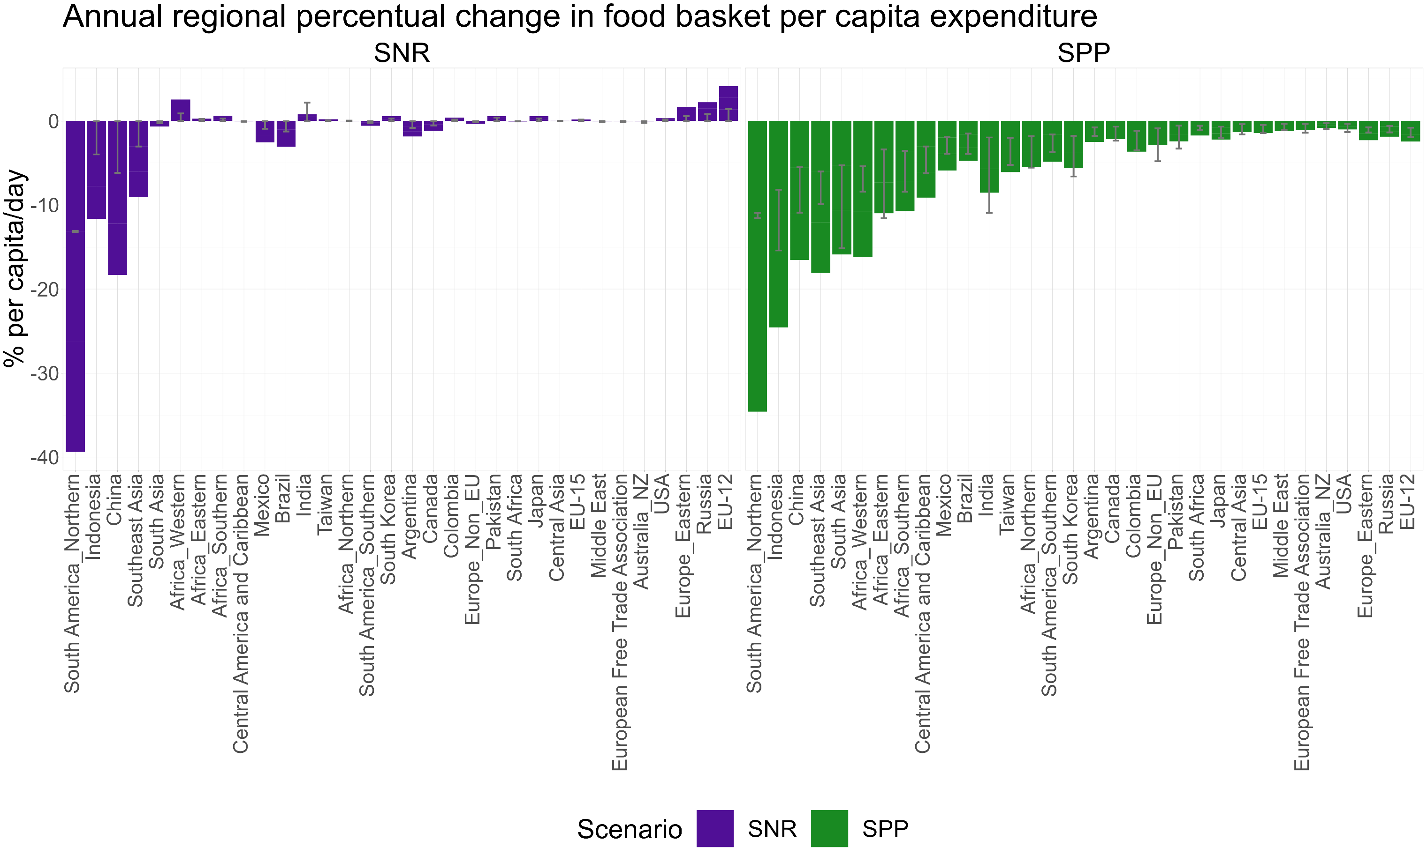
Nutritional point of view
Fig: food expenditure by capita daily

Slide 26
Next steps
Fig: mitigation cost
The idea is to cap all scenarios that do not meet the nutritional requirements

Slide 27



Clàudia Rodés Bachs
claudia.rodes@bc3research.org
#iam-compact
iam_compact
iam-compact
iam_compact

